Slide 1
Minimum Cost Spanning Tree
Select n-1 edges from given n-vertex graph such that the selected edges form least cost spanning tree.
There are three different greedy strategies to select n-1 edges resulting in three different algorithms for Minimum cost spanning tree
Kruskal’s
Prim’s
Sollin’s

Slide 2
Identify the number of distinct minimum spanning trees for the weighted graph given below:

Slide 3
Kruskal’s Algorithm
Greedy criterion: From the remaining edges, select a least cost edge that does not result in a cycle when added to a set of already selected edges.

Slide 4
Kruskal’s Algorithm

Slide 5
Kruskal’s Algorithm
T = ∅
foreach v ∈ V: MAKE-SET(v)
foreach (u, v) in E ordered by weight(u, v), increasing:
if FIND-SET(u) ≠ FIND-SET(v):
T = T ∪ {(u, v)}
UNION(u, v)
return A
Source: Kruskal's Algorithm – Minimum Spanning Tree (MST) - Complete Java Implementation | TutorialHorizon

Slide 6
Trace Kruskal’s Algorithm for the graph given below:

Slide 7
Kruskal’s Algorithm
T = ∅ O(1) time
foreach v ∈ V: MAKE-SET(v) O(n) time
foreach (u, v) in E ordered by weight(u, v), increasing: O(e) time. For sorting O(eloge) time
if FIND-SET(u) ≠ FIND-SET(v): O(elogn)
T = T ∪ {(u, v)} O(n)
UNION(u, v) O(n)
return A
Complexity: O(eloge) i.e O(elogn) since e =O(n²)
Source: Kruskal's Algorithm – Minimum Spanning Tree (MST) - Complete Java Implementation | TutorialHorizon

Slide 8
Prim’s Algorithm

Slide 9
Prim’s Algroithm

Slide 10
Prim’s Algorithm
1. mst[] to keep track to vertices included in MST.
2. key[s]=0 and key[v]= +∞ for all v in V-{s}, s is the start vertex O(n)
3. Repeat the following steps until all vertices are processed O(n)
Pick the vertex u which is not in mst[] and has minimum key. O(n) for all v O(n²)
Add vertex u to mst[]. O(n)
For adjacent vertex v, if v is not in mst[] and edge u-v weight is less than the key of vertex v, key[v] then update the key[v]= edge u-v weight. O(n²) if adjacency matrix is used
4. Return mst[].
If we use binary heap and adjacency list then complexity is O(elogn) same as Kruskal’s
If we use Fibonacci heap and adjacency list then the complexity is O(e + nlogn)
Source for algo and example: Prim’s Algorithm - Minimum Spanning Tree (MST) | TutorialHorizon

Slide 11
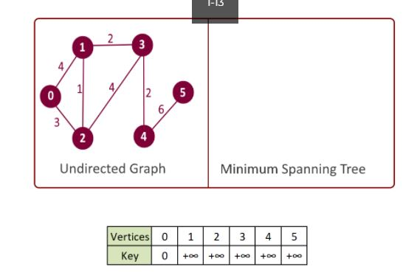
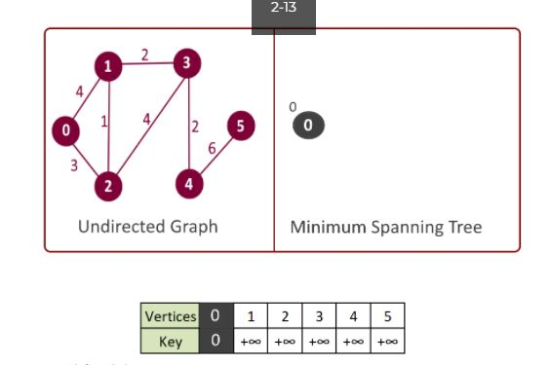
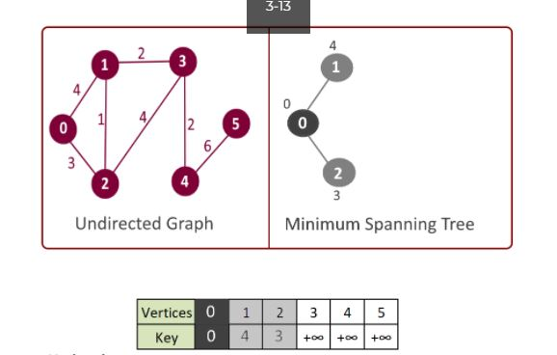
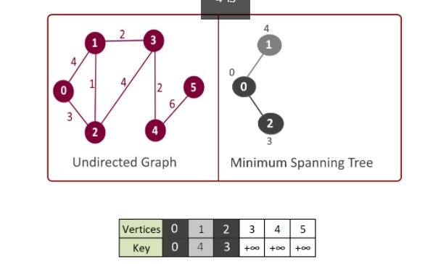

Slide 12
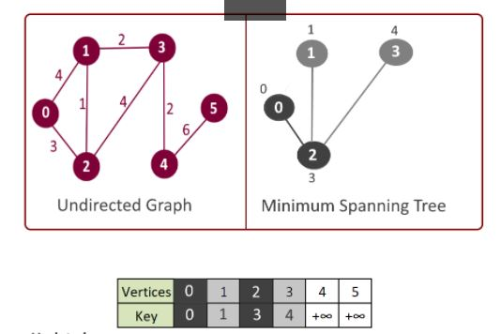
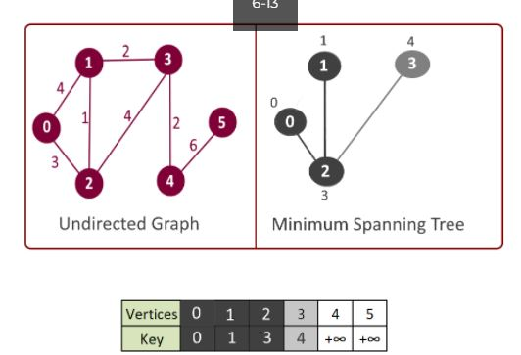
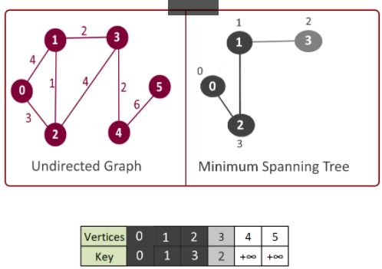
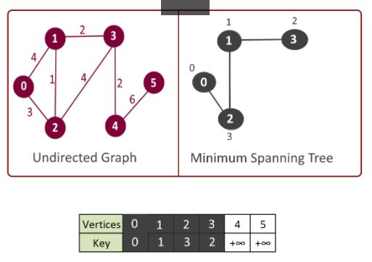

Slide 13
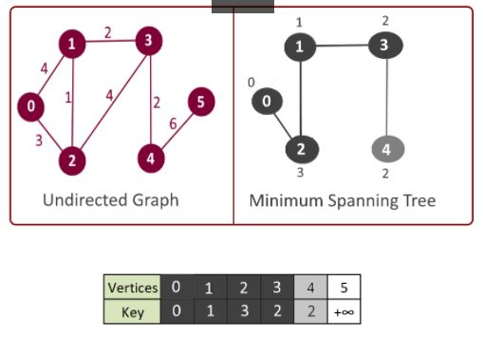
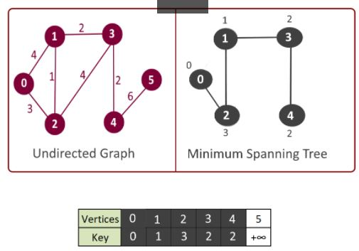
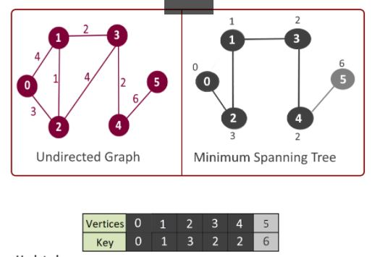
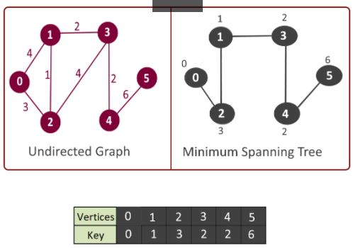

Slide 14
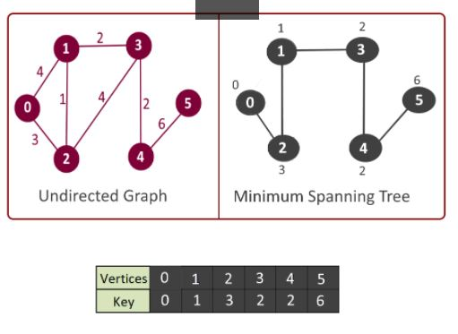

Slide 15
Trace Prim’s Algorithm for the graph given below:

Slide 16
Bipartite Cover Problem
An undirected graph G is said to be Bipartite graph if its vertices can be partitioned in to sets A and B such that no edge in the graph connects two vertices in the same set.
A’ subset of A, is said to cover the set B iff every vertex in B is connected to at least one vertex of A’
A’ is said to be minimum cover if A has no subset of smaller size that covers B
The problem of finding minimum cover in a Bipartite graph is Bipartite cover problem

Slide 18
Pseudocode

Slide 19
Algorithm
Cover_size=0
New_vertex[i]= degree[i] for all i in A
Covered[i]=false for all i in B
While (New_vertex[i] >0 for some i in A)
{ Let v be a vertex with largest New_vertex[i]
Final_Cover[cover_size++]=v
for (all vertices j adjacent from v)
{ if (! Covered[j])
{ Covered[j]=True
Reduce New_vertices[k] by 1 for all vertices k adjacent from j
}}}
If (some vertices are uncovered) fail
Else a cover has been found
Complexity O(|A|²+n+e)

Slide 20
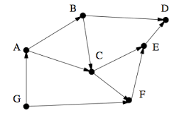
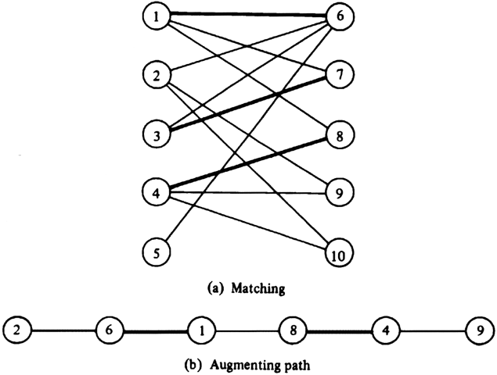
DAA-ICT 2257 (Tutorial)
For all the questions trace the algorithm and show the steps clearly. Also specify the time complexity of algorithm used.
Fig 1 Fig 2
Obtain topological sequence for the graph given in Fig 1. using greedy technique.
Obtain Bipartite cover for the graph given in Fig 2. using greedy technique.

